Slide 2

Topics
Introduction to Inheritance
Polymorphism

Slide 3
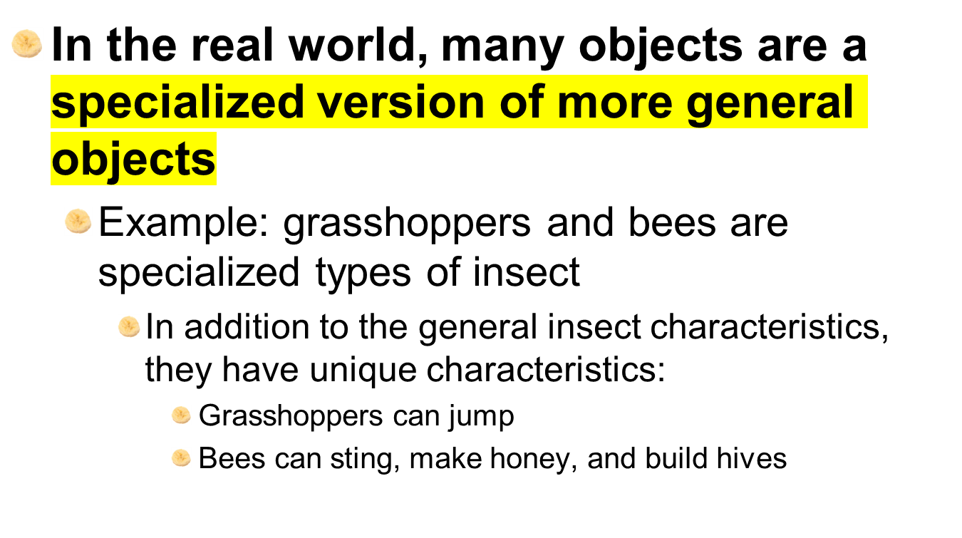
Introduction to Inheritance

Slide 4
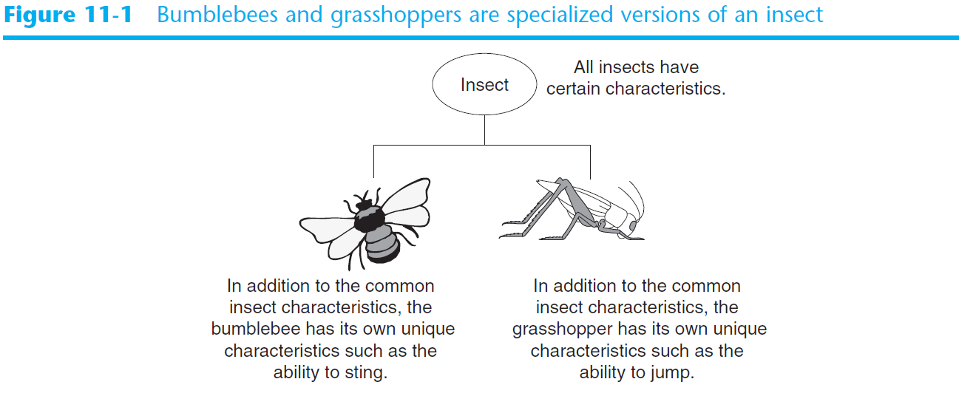
Introduction to Inheritance (cont’d.)

Slide 5

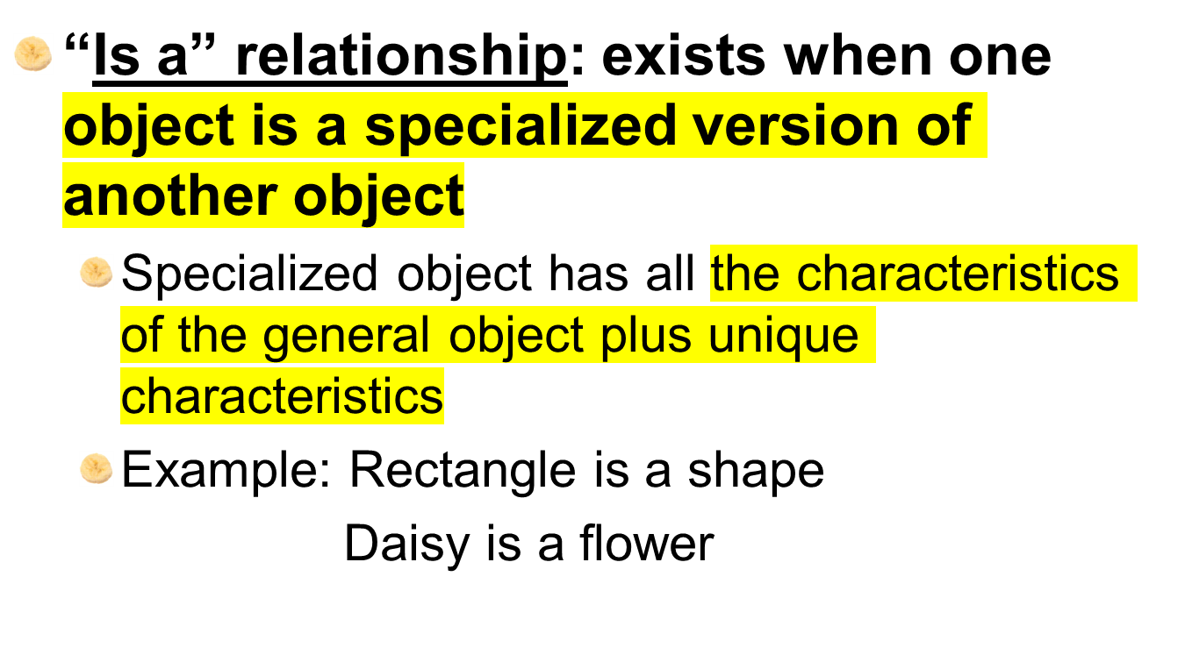

Slide 6
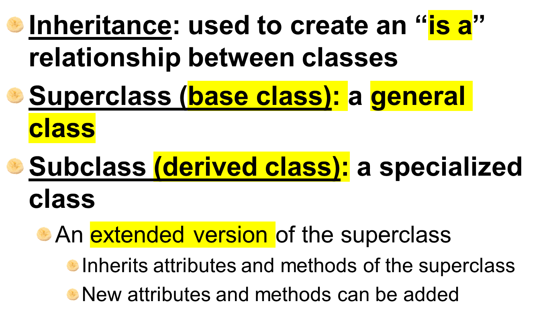
Inheritance and the “Is a” Relationship (cont’d.)

Slide 7
Inheritance and the “Is a” Relationship (cont’d.)
For example, need to create classes for cars, pickup trucks, and SUVs
All are automobiles
  Have a make, year model, mileage, and price
  This can be the attributes for the base class
In addition:
  Car has a number of doors
  Pickup truck has a drive type
  SUV has a passenger capacity

Slide 8
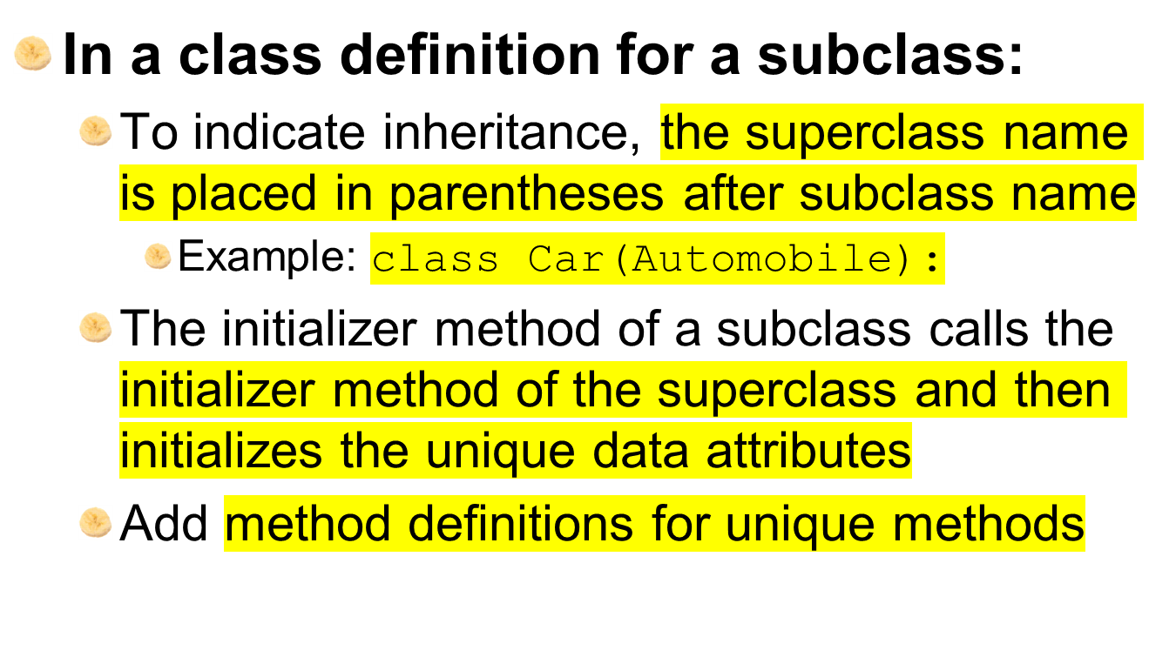
Inheritance and the “Is a” Relationship (cont’d.)

Slide 9
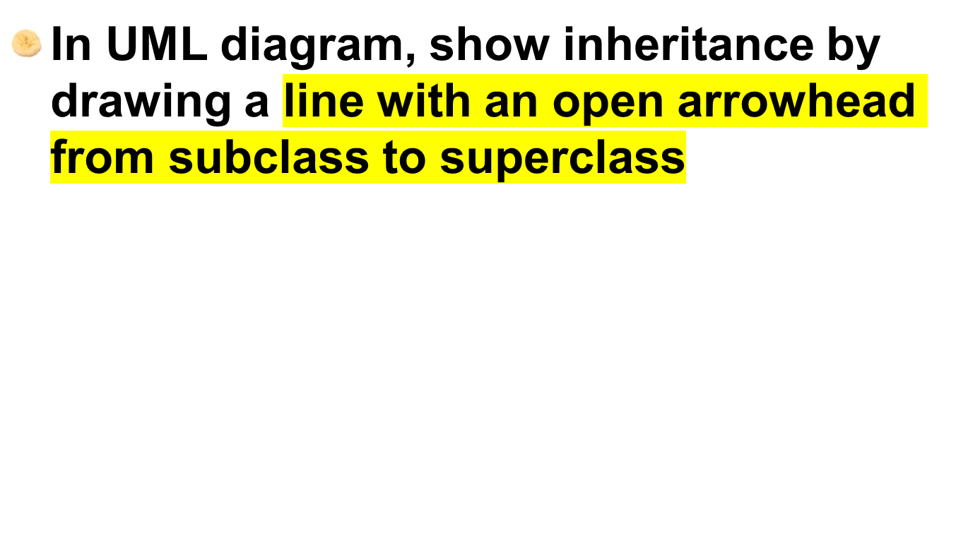
Inheritance in UML Diagrams

Slide 10
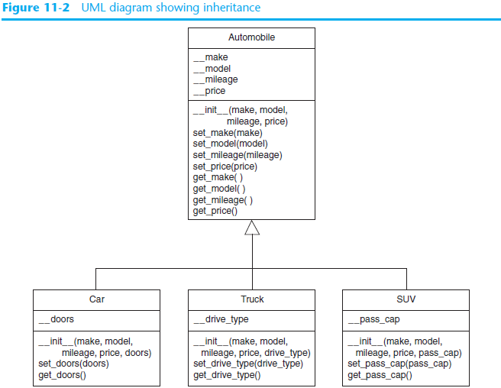

Slide 11
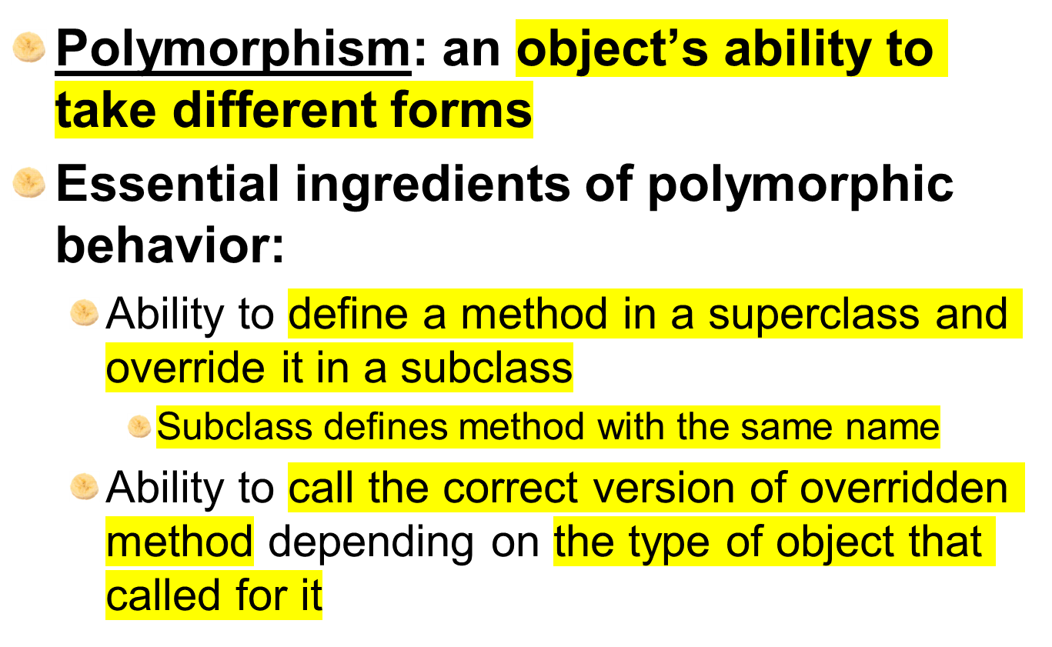
Polymorphism

Slide 12
Polymorphism (cont’d.)
In previous inheritance examples showed how to override the __init__ method
  Called superclass __init__ method and then added onto that
The same can be done for any other method
  The method can call the superclass equivalent and add to it, or do something completely different

Slide 13
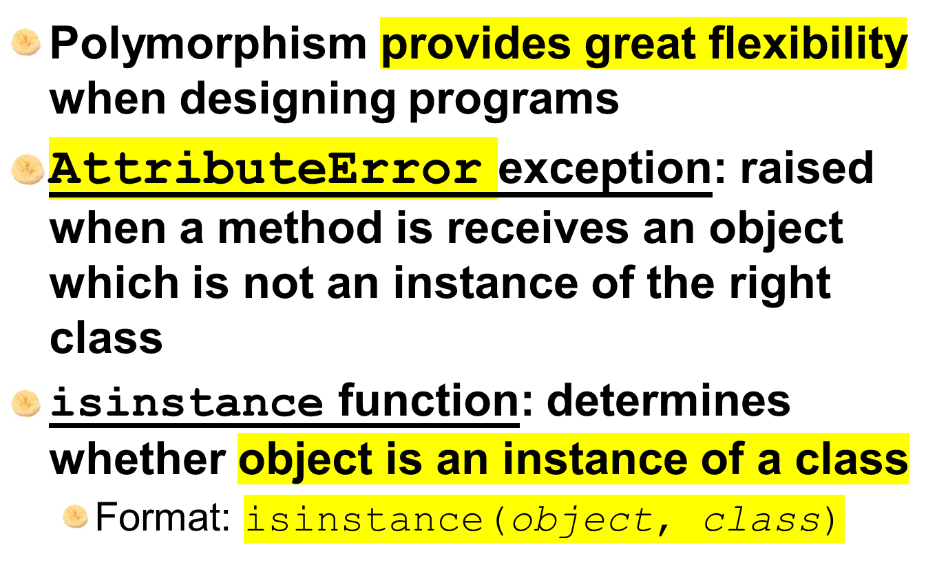
The isinstance Function

Slide 14
Summary
This chapter covered:
  Inheritance, including:
    “Is a” relationships
    Subclasses and superclasses
    Defining subclasses and initializer methods
    Depicting inheritance in UML diagrams
  Polymorphism
  The isinstance function

